Slide 1
Posting Approval Matrix- Scope

Slide 2
Overview
In KOKO we are using Odoo ERP to manage all Finance related activities. To manage any finance related system the Journal Entry posting is a big part of process.
In KOKO we have multiple types of Journals using which the entries are been posted. Some of the Journals are posted automatically in the system the system through automated process create to support operations [e.g. Customer Invoices for Cooker and fuel sales, Vendor Bill for Agent Commission etc.].
But some of the Journal Entries are posted by Accounts teams manually on a day to basis. These Journal entries very important and contain big numbers too, that is why it is very important to post them correctly in the system.
In order to maintain the sanity of the manual Journal Entries Posting, Finance team need to have a approval Process where they can set up the hierarchy of the Approval to post any Journal entry [Of specific Kind of Journal]

Slide 3

Current Process

Slide 4
Current Process
In the current Process of finance department, we have multiple users, who usually perform multiple activities. In current state all the users can create the journal entries and Post them in the system which will directly impact our finance reporting.
In System Following are the Finance team member creating the Manual Journals:
Doreen Gichuru
George Wambugu
Innocent Kisuge
James Njoroge
Mitchelle Morema
In system the Journal Entries for following Journal are created manually by the Finance team:
INTERCOMPANY JOURNAL
Agent Incentive
CITIBANK KES [And Multiple Other Bank Accounts like CBA]
Escrow Accounts
Salaries Journal
and other Multiple Journals

Slide 5
Change Required
The Finance team requires the Process as follows:
Where they can configure the Journals and the approvers for the journals Entries.
If required we can put validation on the the Amount of the Journal Entries as well.
For a specific Journal We can add Multiple Approver if required. [Also we can setup the Multiple Approvers based on the Monetary Value]

Slide 6
Change Required
The Finance team requires the Process as follows:
Where they can configure the Journals and mark it as need approval true for manual entries.
Selected Journals will go through workflow draft>>validate/post entry.
In other automated journal entries feature needs to be available for locking the user for manual entries for those selected journals.
In case of Vendor bills journal, entries with Supplier (=True) should be available for manual entry while Agent(=True) should be automated through scheduled action.
List of Journals with Lock required and Approval required is been provided by finance team.

Slide 7
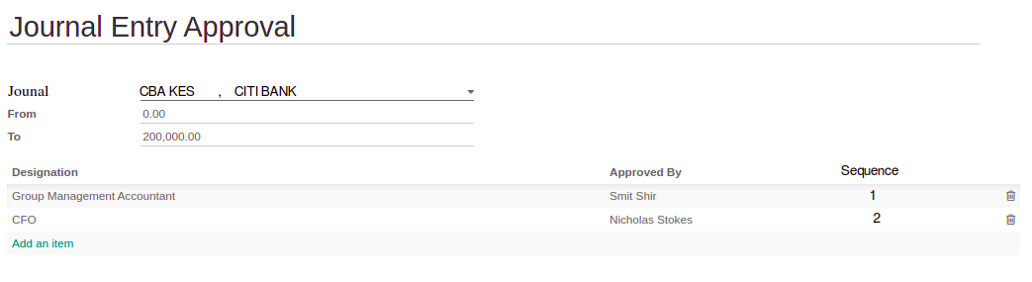
Proposed Solution
We can create the Process where we can select one or Multiple Journal for which we need to have similar approval Process. [We can create multiple such records]
In the Same Record we can add the Approver list in a Proper sequence and They must be able the Approve the Journal Entry in that order only.
Once the last approval will happen the Journal Entry will be posted and impact the Finance reporting.

Slide 8
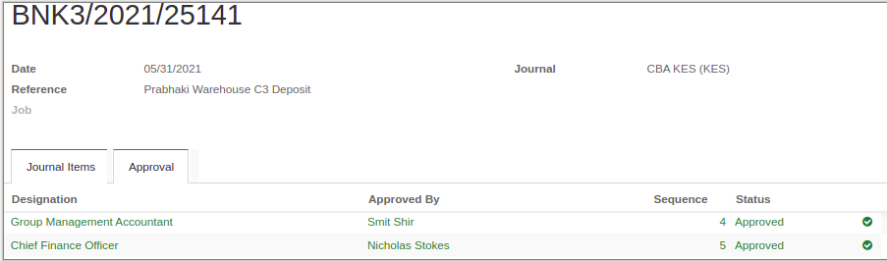
Proposed Solution
Once the Final Approval will be done, the JE will be in Posted state.

Slide 9
Madhav Agarwal
m.agarwal@kokonetworks.com

